Slide 1

Time Interactive Notebook
Name:
Class:
Teacher:
Term 3 Semester 2
1

Slide 2
Contents
Glossary or Formula Page
Page
Date
Description
2
3

Slide 3
24
7
30
Tasks
Essential Question
Questions
Notes
Summary
4
5

Slide 4
Knowledge of Time Quick quiz. (LHS)
When is the next leap year?
Why do we need a leap year?
Which months have 31 days?
Which months have 30 days?
What does (BC) BCE or (AD) CE mean?
Is time the same, all over the planet, our globe called Earth?

Slide 5
Fun Facts on Time
Time in minutes and seconds is based on the number……..
Thanks to the ancient Babylonians who used a Base-60 system.
Other units of time are based on the rate that the Earth spins on it’s axis.
The ancient Egyptians described the 24 hour day as 12 hours of day and 12 hours of night.
The solar calendar recognizes that the Earth takes about 365 ¼ days to orbit the Sun. This gave us the leap year, one extra day every four years. Leap years have 366 days, 29th of February is the extra day.
The Olympics occur on leap years.
Julius Caesar introduced the solar calendar.

Slide 6
Learning Intentions
Students will be able to
Convert between units of time (seconds, minutes, hours, days, weeks etc.)
Convert time from 24 hour clock to AM/PM and vice versa.

Slide 7
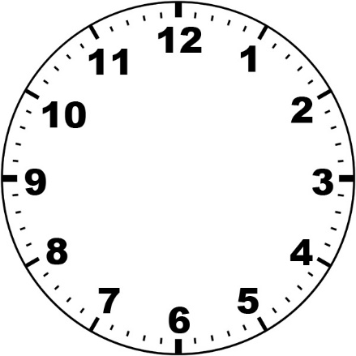
24
7
30
Units of Time
Date:
EQ – How do we convert units of time?
How do I tell time on an analogue clock?
The shorter hand tells us the hour
The longer hand tells us the minutes past (or to) the hour
It’s 1 o’clock
How do I tell time on a digital clock?
Hour
Minutes past the hour
01:00
This Photo by Unknown Author is licensed under CC BY
Notes:
Just in case the students need a reminder about reading clocks.

Slide 8
https://www.youtube.com/watch?v=UXcNV472GGY
Notes:
This clip provides a 4 minute description of time conversion and builds a single conversion loop that leads nicely to the caterpillar on the next slide.

Slide 9
24
7
30
Units of Time
Date:
EQ – How do we convert units of time?
The standard unit of time is seconds (s)
Time Conversion Caterpillar
Day Hour Minutes Second
Year Fortnight Week Day
There are 12 months in a year
How do I convert unit of time?
× 24
× 60
× 60
÷ 24
÷ 60
÷ 60
× 26
× 2
× 7
÷ 26
÷ 2
÷ 7

Slide 10
24
7
30
Units of Time
Date:
EQ – How do we convert units of time?
What is a decade?
Decade is 10 years
Century is 100 years.
What is a century?
Example :
A) 3 days = _______ minutes
3 days = 3 x 24 h 1 day = 24 hours
= 72 hours
= 72 x 60 min 1 hour = 60 minutes
= 4320 min
B) 30 months = ________ years
= 30 ÷ 12 1 year = 12 months
= 2 ½ years

Slide 11


Slide 12
Independent Practice
Converting Time Units Worksheet [10 mins]

Slide 13
http://education.abc.net.au/home#!/media/1566174/late-again-

Slide 14
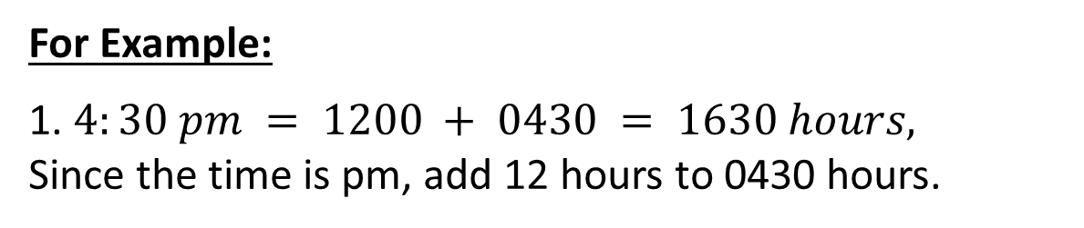
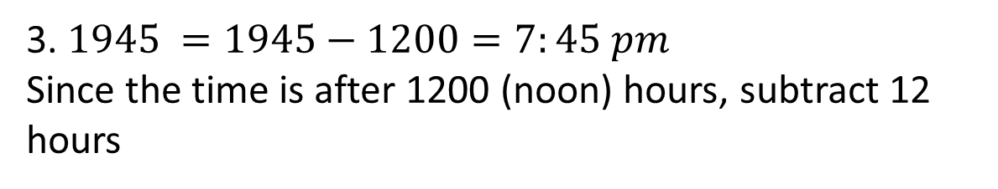
24
7
30
Units of Time
Date:
EQ – How do we convert units of time?
What is 12 hours time?
Today we use
am – ante meridiem – Latin for (before noon) and
pm – post meridiem (after noon).
What is 24 hours time?
24-hr Time shows the number of hours and minutes after midnight.
For Example:
1. $4:30 pm = 1200 + 0430 = 1630 hours,$
Since the time is pm, add 12 hours to 0430 hours.
2. $7 am =0700 hours$
3. $1945 =1945−1200=7:45 pm$
Since the time is after 1200 (noon) hours, subtract 12 hours

Slide 16
Independent Practice
12 hours and 24 hour time Worksheet [10 mins]

